Slide 1
Capstone 1 Project: Jobs for H-1B Visa
Jasmine Kyung
Springboard Data Science Career Track

Slide 2
Background
The H-1B Visa is a highly desired non-immigrant visa and the most common visa status applied for and held by international students upon graduating college/higher education and work in a full-time position. Not every company is willing to support the visa so immigrants tend to have a more difficult time finding a job. This project will attempt to predict which applications will more successfully get a visa.
Clients
Government
Any Employer
Immigrant Workers/Graduating International Students
Database
Kaggle H-1B Visa Petitions 2011-2016

Slide 3
DATA WRANGLING

Slide 4
DATA WRANGLING
READ CSV FILE
INSPECT AND CHECK MISSING DATA
DROPNA()
FIND AND REMOVE OUTLIERS
USE BOXPLOTS AND SUMMARY
DATAFRAME FILTERING
FIX STRING VALUES
UPPER()
CREATE NEW FIELD “STATES” AND FIX STRING VALUES
SAVE CLEANED FILE

Slide 5
EXPLORATORY DATA ANALYSIS

Slide 6
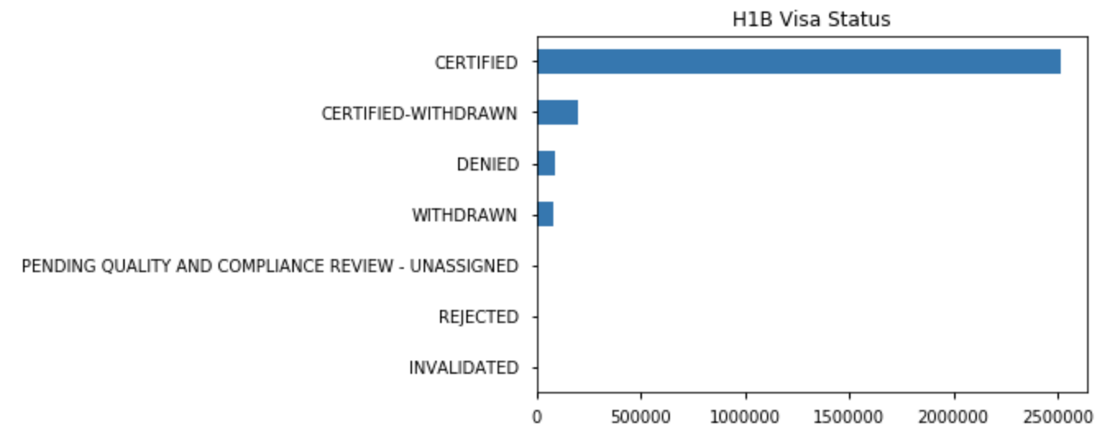
EDA H-1B Visa Status

Slide 7
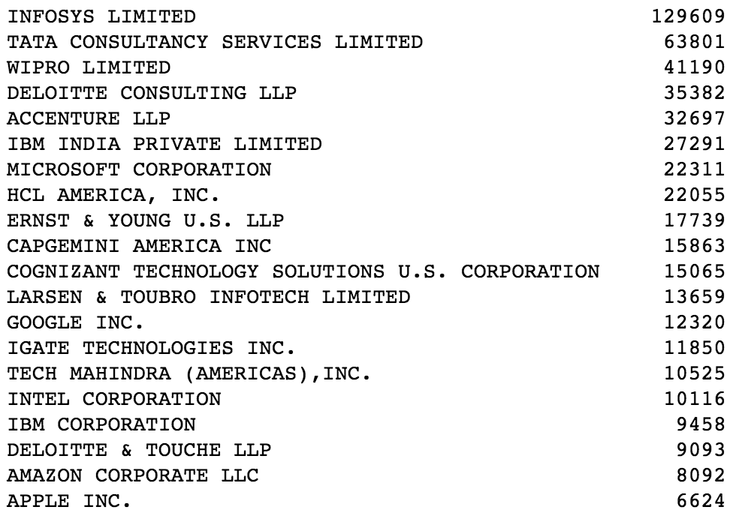
EDA Top 20 Companies with Certified H-1B Visas

Slide 8
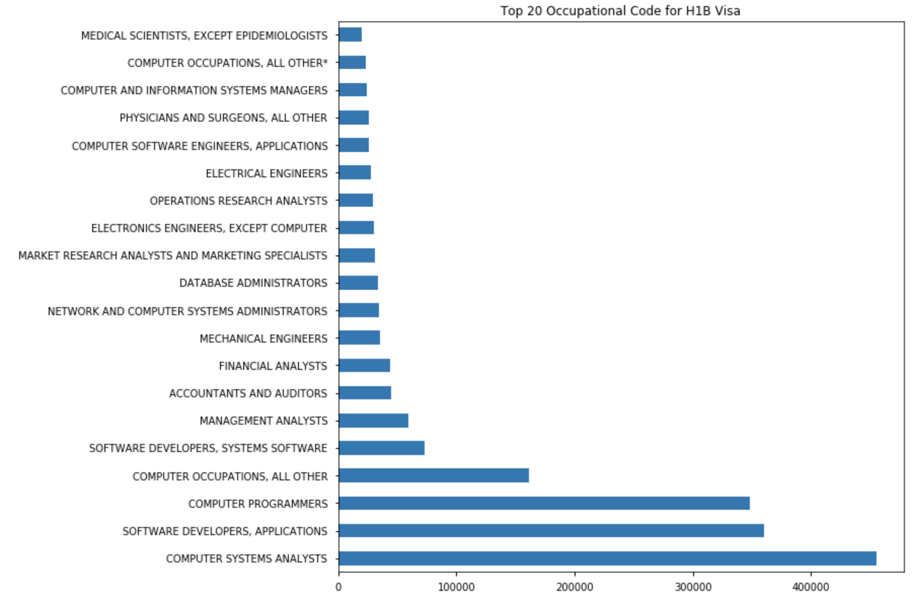
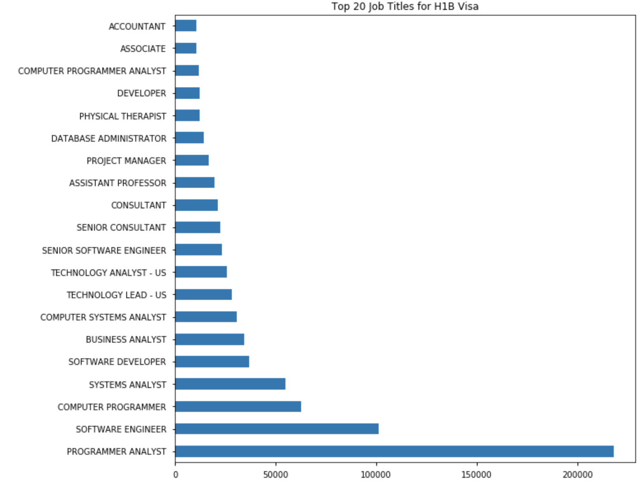
EDA Top 20 Occupations and Job Titles with H-1B Visa Petitions

Slide 9
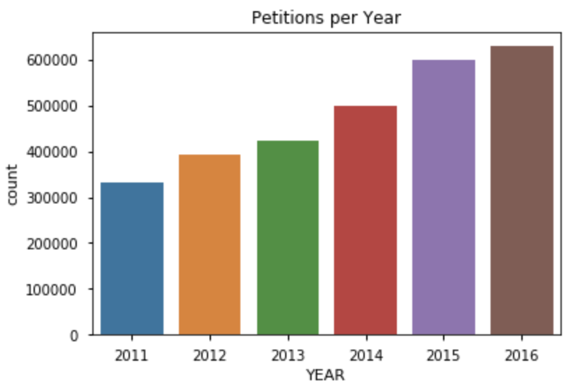
EDA Petitions per Year

Slide 10
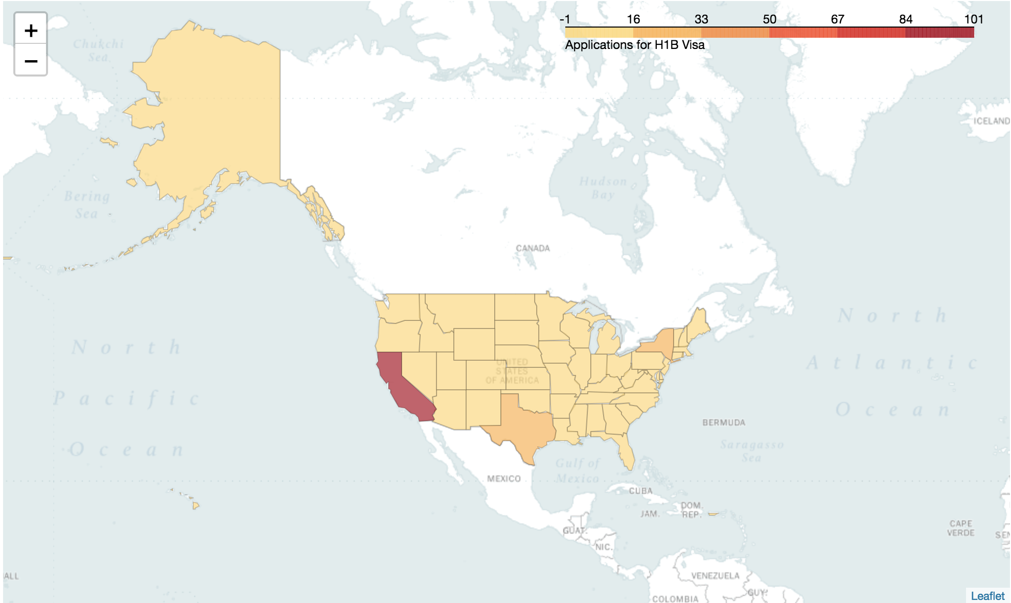
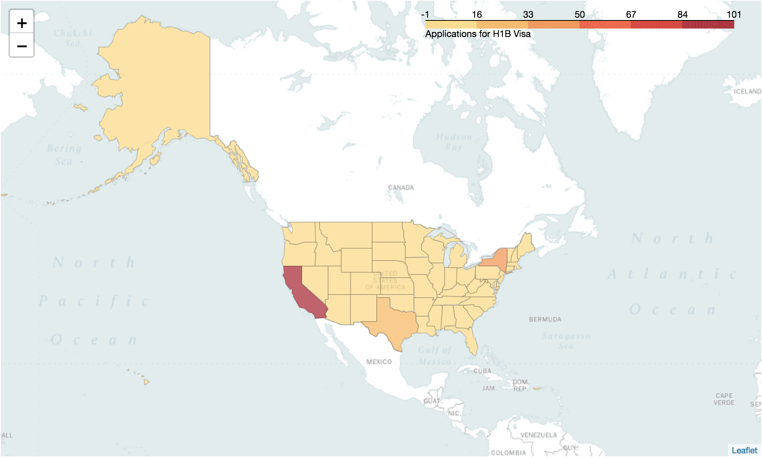
EDA Chloropleth of Certified and Denied Visas
Certified
Denied

Slide 11
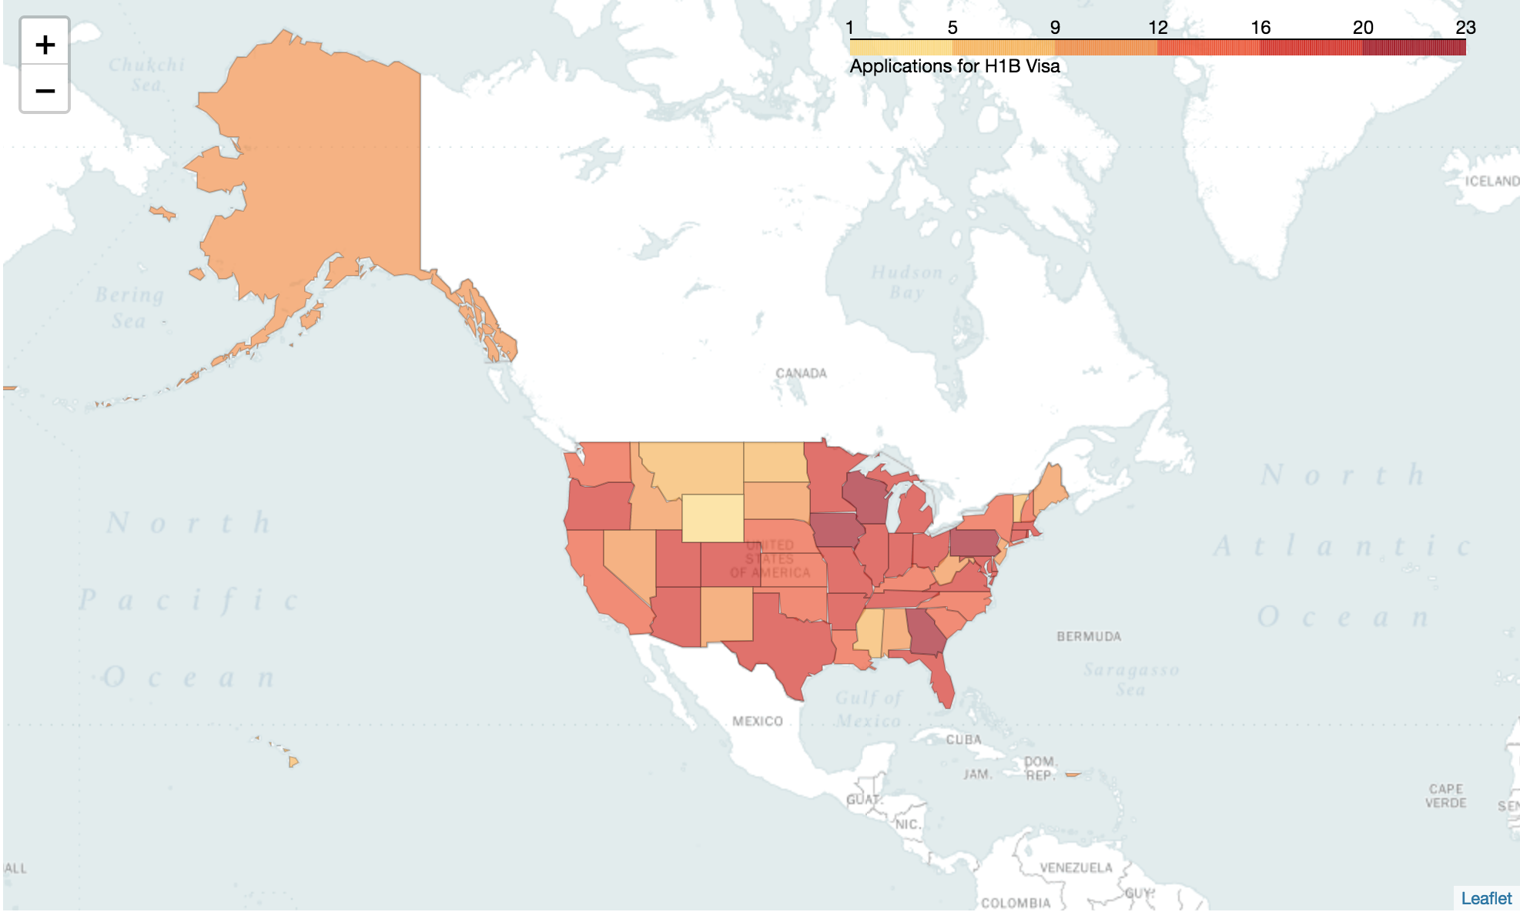
EDA Chloropleth of Computer Systems Analyst
(Certified)

Slide 12
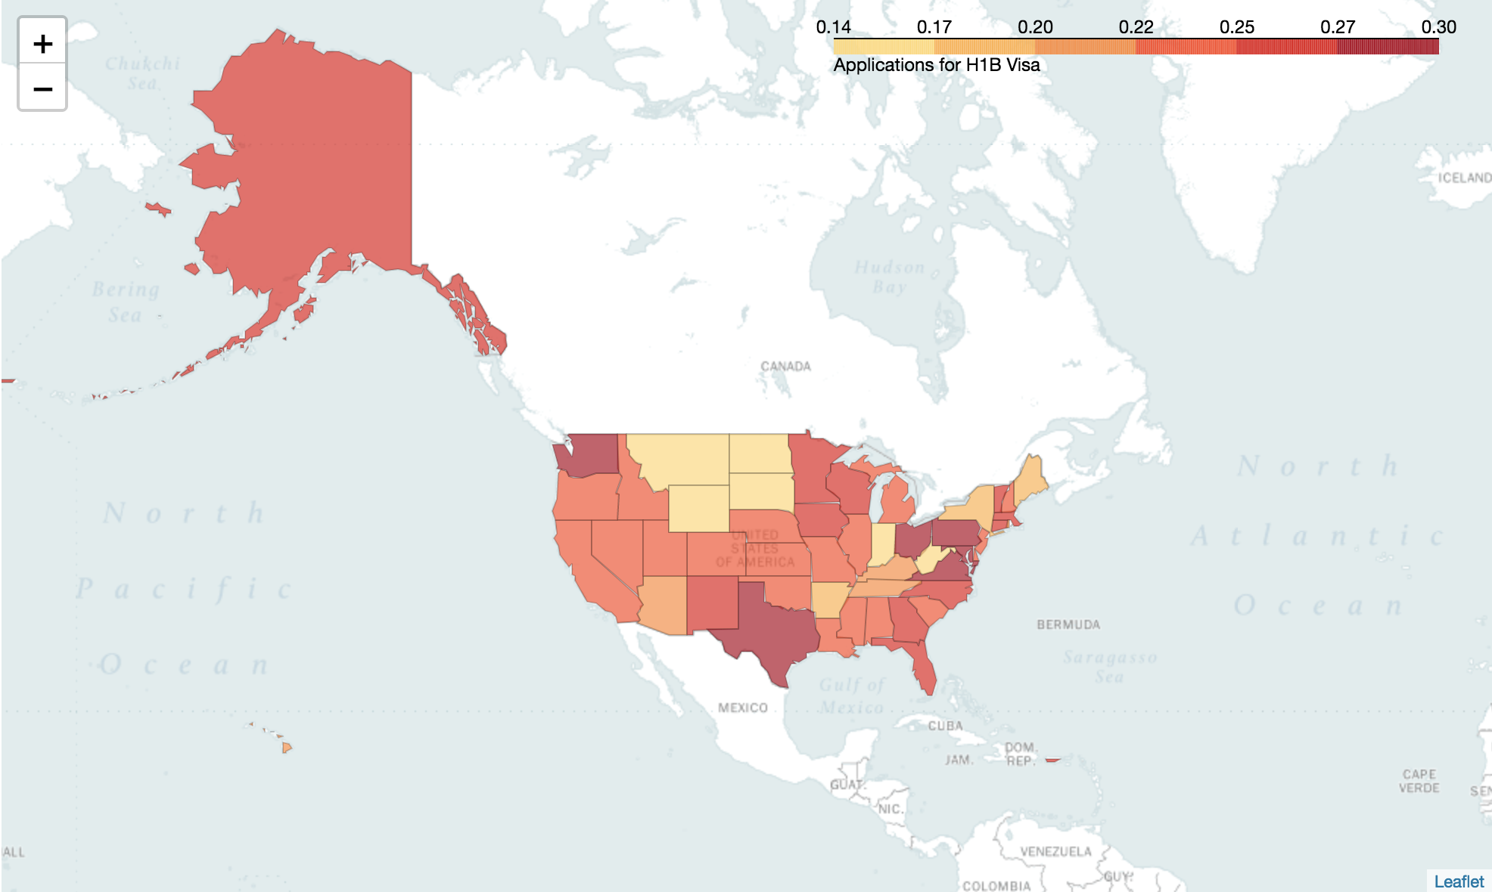
EDA Chloropleth of Computer Systems Analyst
(Denied)

Slide 13
INFERENTIAL STATISTICS

Slide 14
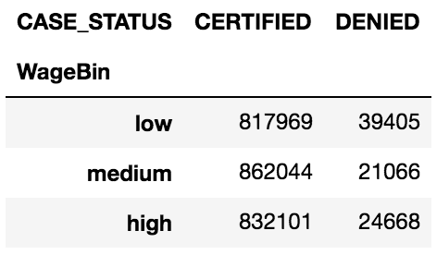
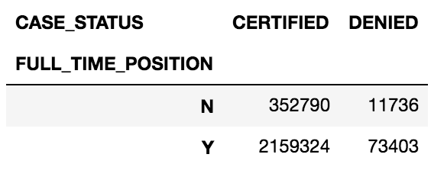
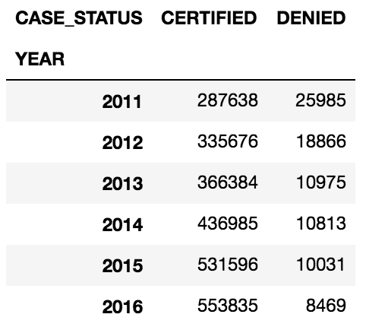
INFERENTIAL STATISTICS Crosstab Examples

Slide 15
INFERENTIAL STATISTICS Chi-Square Summary
 | χ² | p value | α (Chi-square critical)
Employer Name | 831584.91 | 0.00 | 211974.42
Soc Name | 93823.43 | 0.00 | 1542.79
Job Title | 432486.66 | 0.00 | 266187.58
Full Time Position | 4.56 | 0.03 | 3.84
Prevailing Wage | 7346.31 | 0.00 | 5.99
Year | 39727.86 | 0.00 | 11.07
State | 8618.26 | 0.00 | 68.67

Slide 16
RECOMMENDATIONS, NEXT STEPS, AND CONCLUSION

Slide 17
RECOMMENDATIONS, AND CONCLUSION
Apply for jobs within the computer systems analyst occupation in companies that are involved with information technology, consulting, and internet industries. Best states to apply in are Indiana, Arkansas, Tennessee, Arizona, and Connecticut.
The government should consider ways to accommodate such a demand and employers can also prepare to find a steady stream of international candidates and know how to accommodate them also should they apply.
International applicants can also be more assured that most H-1B petitions are approved once they obtain a job.

Slide 18
Q&A

